Slide 1

CIS 480/580 Delta Flight Booking System
Team NAU

Slide 2




Meet our Team
Tamer
Ayoub
Yuba
Krishna Oli
Swastik
Lamsal
Grishma
Thapaliya

Slide 3
Content
Project Introduction
Behavior Driven Development
Our Scope
Testing Approach
Testing Objectives
Metrics
Defect #1
Defect #2
Severity/Priority Assessment
DFD Diagrams
Interview w/ Delta Back End Engineer
QA Session

Slide 4




Project Introduction
Delta's Flight Booking System
Booking Process Overview
Test Approach
Database Demo

Slide 5

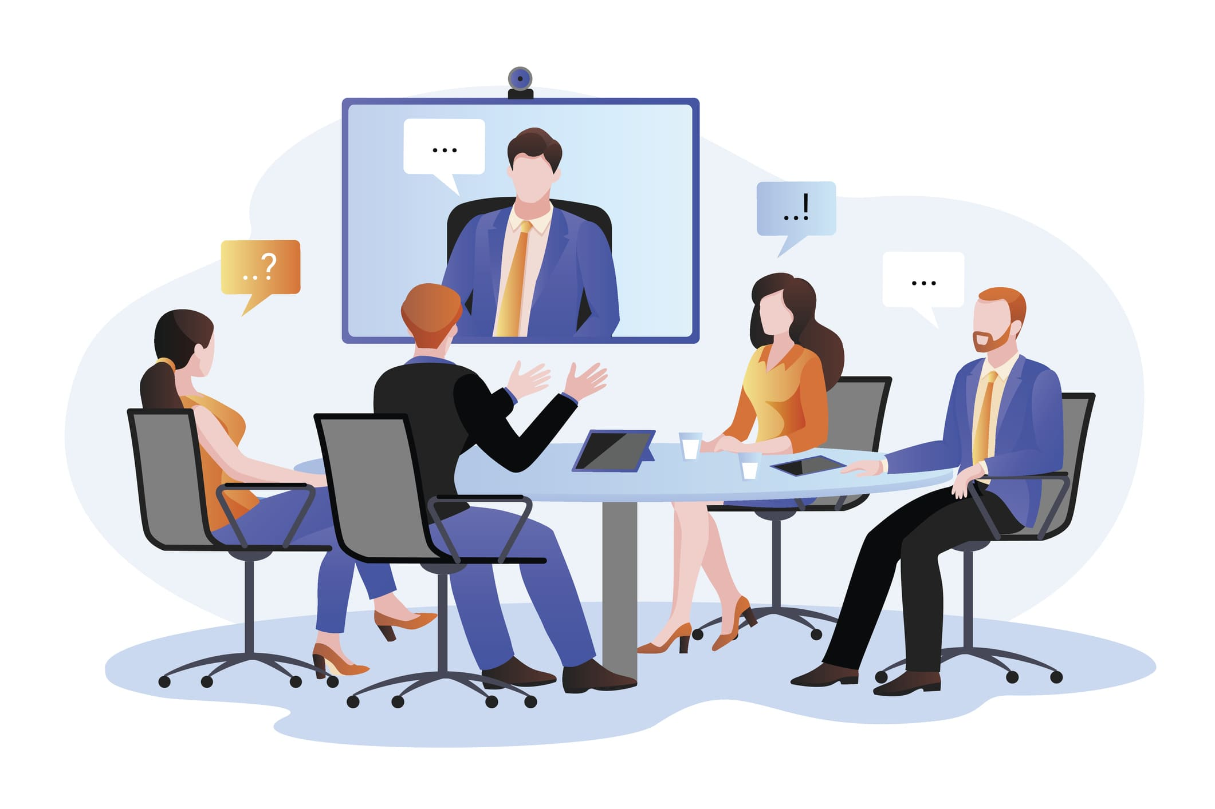
Behavior Driven Development

Slide 6

Our Scope
Validated the Flight Management System of Delta Air Lines that allows customers to Book a Flight.
Tested features such as searching flights, trip type, passengers, seats, and purchase flight.

Slide 7
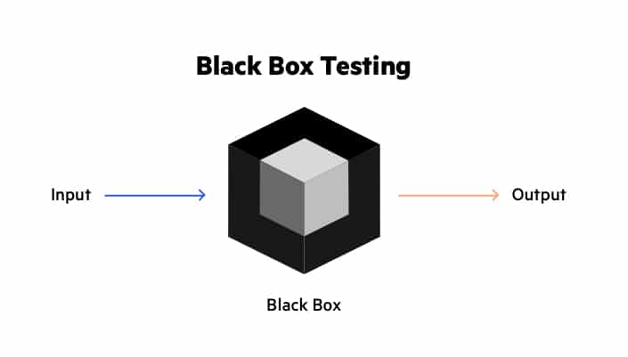
Testing Approach
Applied black box testing.
Tested the Delta website focusing on booking flights.
Performed System and Acceptance Testing where we tested the usability of each features
We applied Persona User testing aswell

Slide 8
Test Objectives
Search Flight
Select Trip Type
Select Passengers
Seats Selection
Page Overview of Selected Flight
Purchase Flight

Slide 9
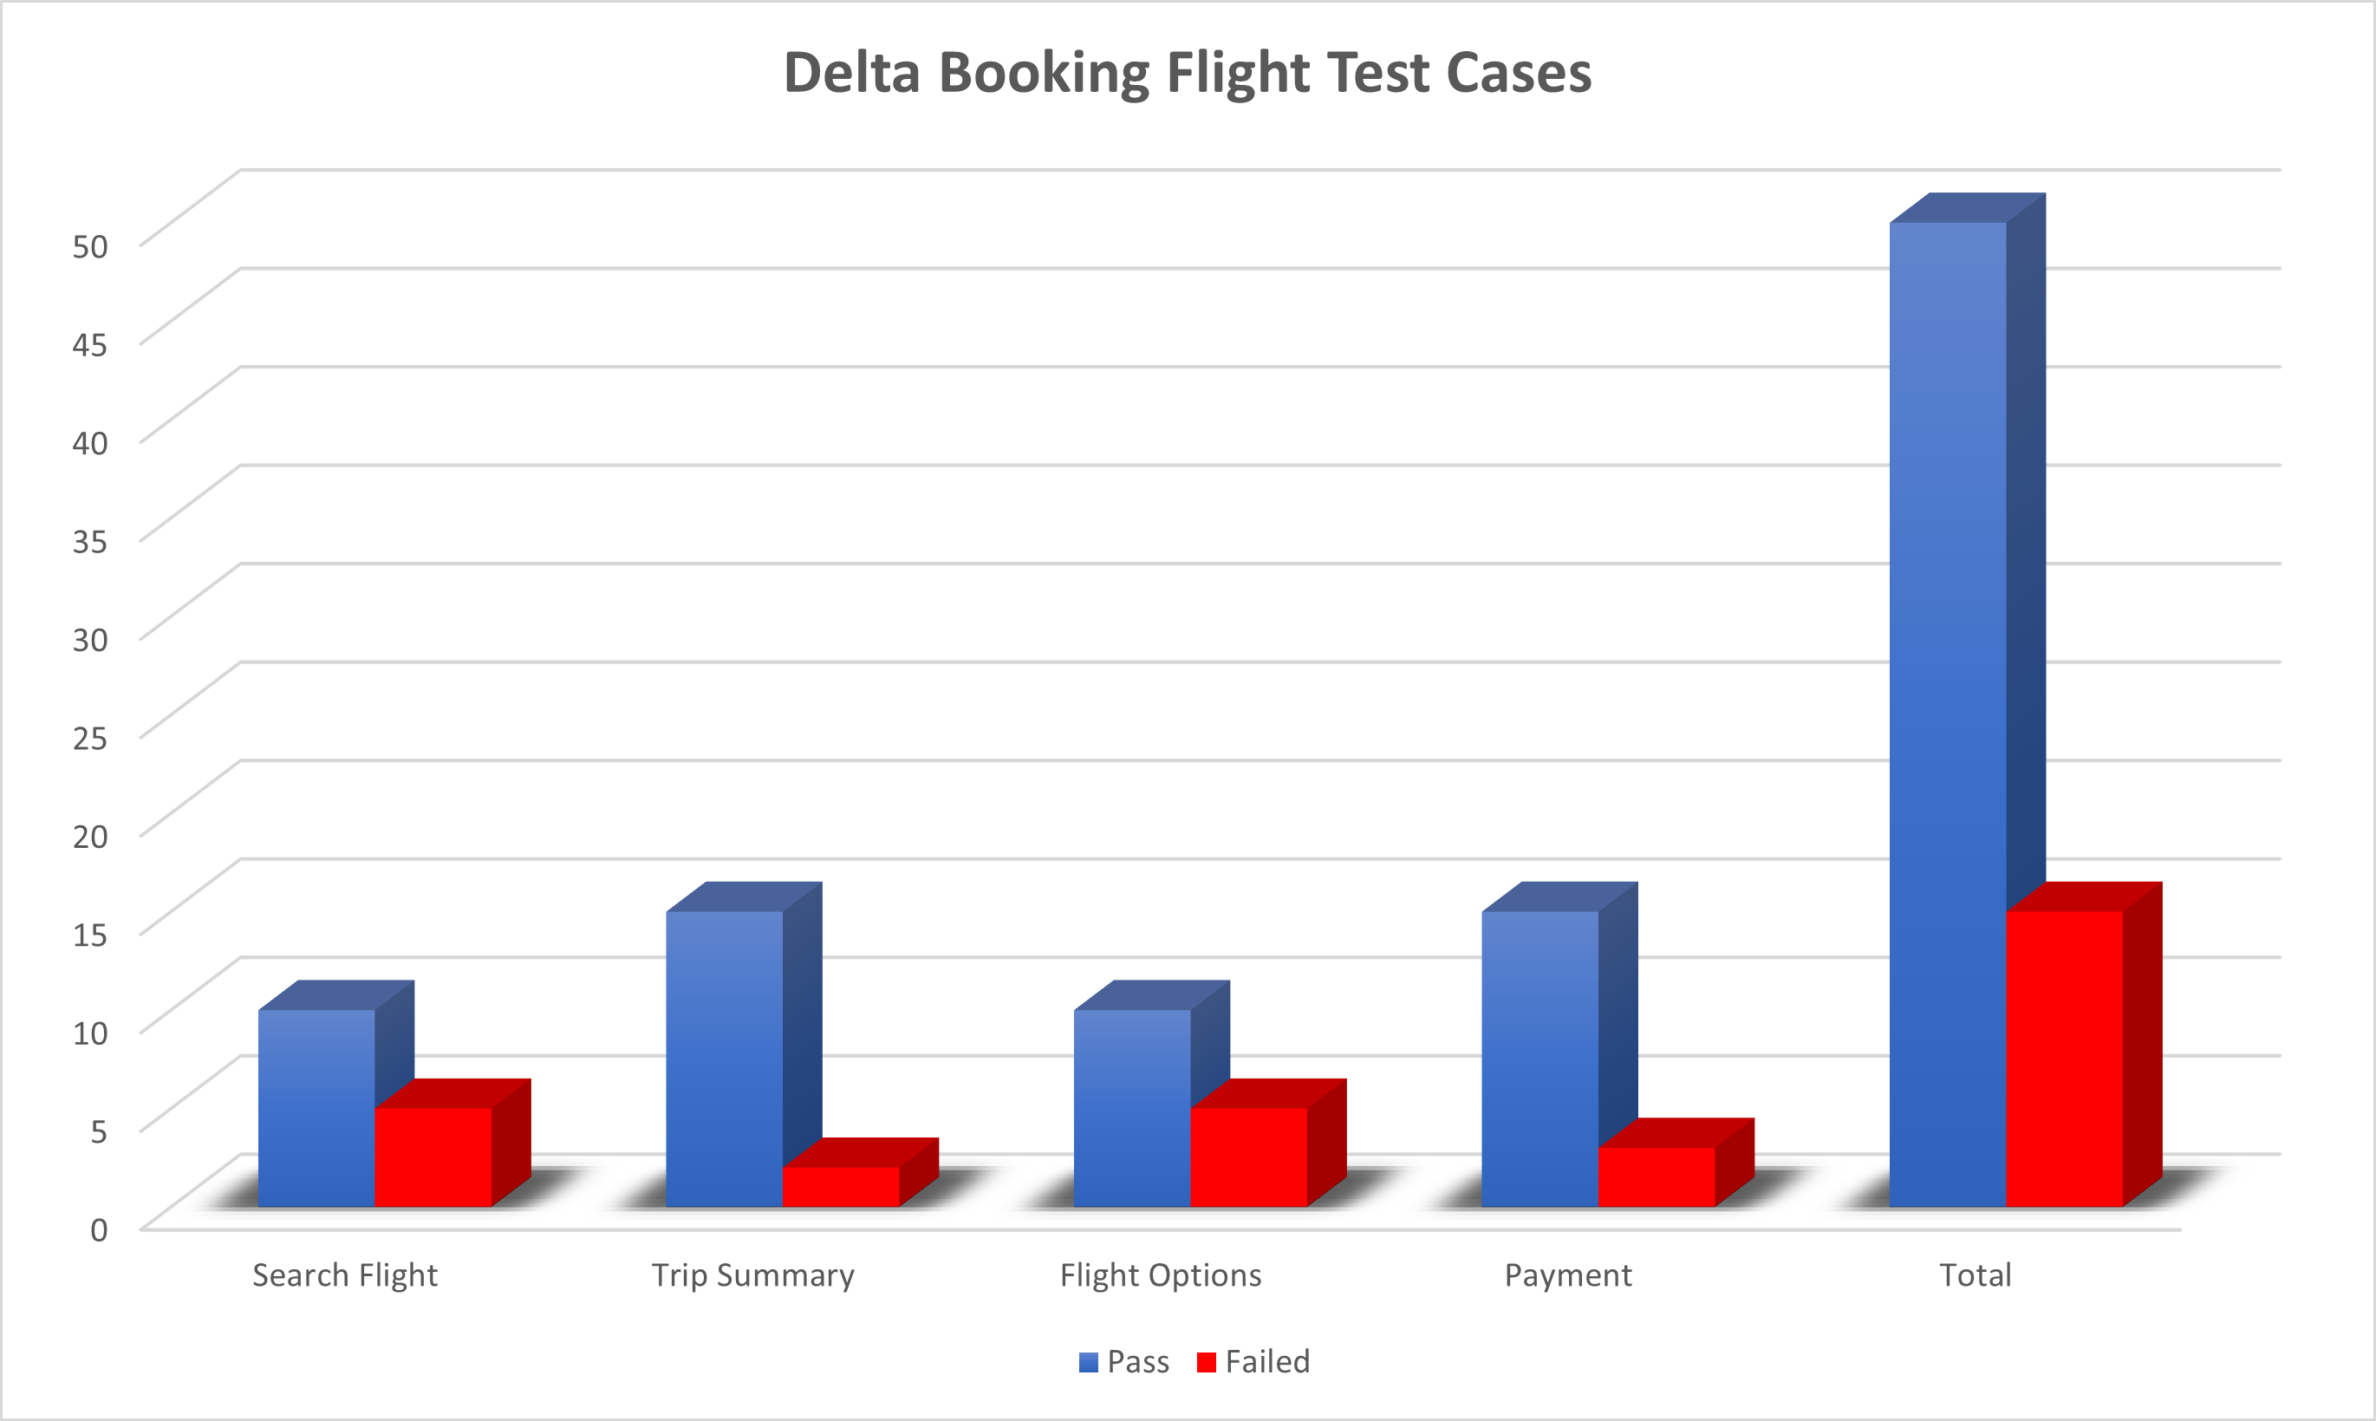
Metrics

Slide 10
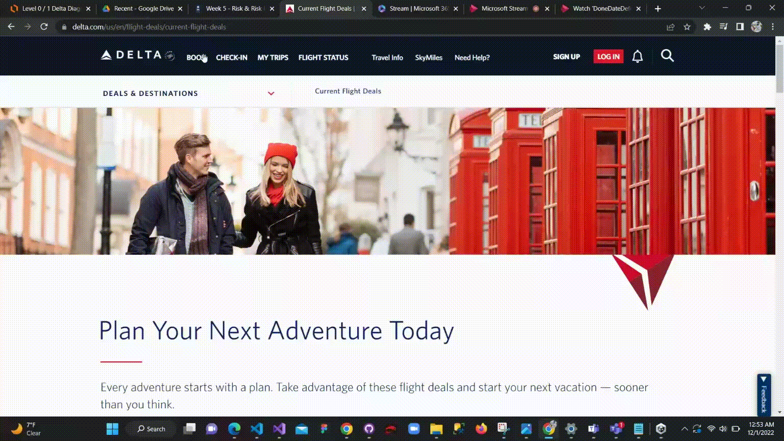
Defect #1: Can't book more than 9 passengers

Slide 11
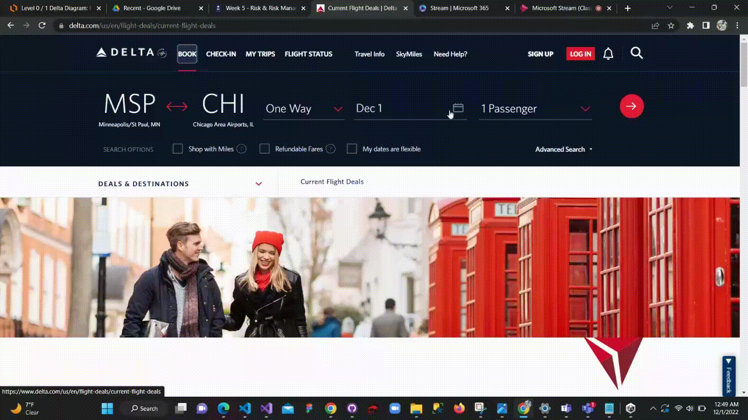
Defect #2: Selecting Done is inefficient

Slide 12
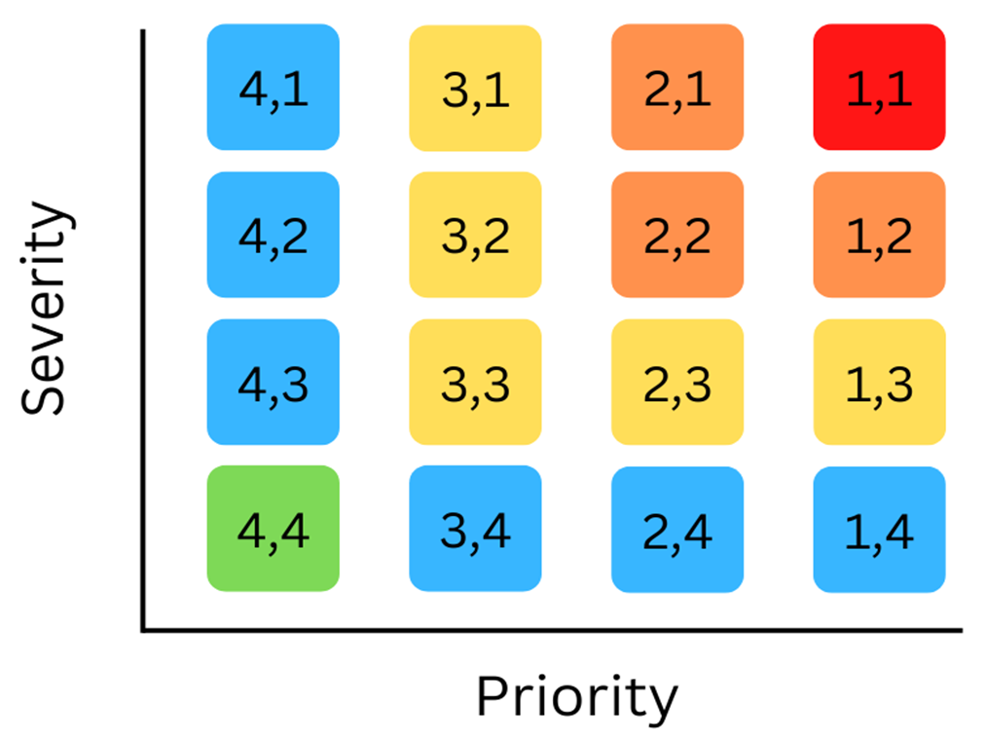
Severity/Priority Assessment
Risk Type | Defects | Assessment
Business Risk | Can't book more than 9 passengers | 2,2
Business Risk | Selecting Done on Selecting Date is inefficient | 3,4
Product Risk | Currency doesn’t convert over from USD to Rupees in Nepal | 4,4
Technical Risk | Russia is still displayable as a search option, when all flights are banned | 4,3

Slide 13

DFD Diagrams
Helped us to visualize the major steps and data involved in the software-system process
Created diagrams using lucid chart.

Slide 14
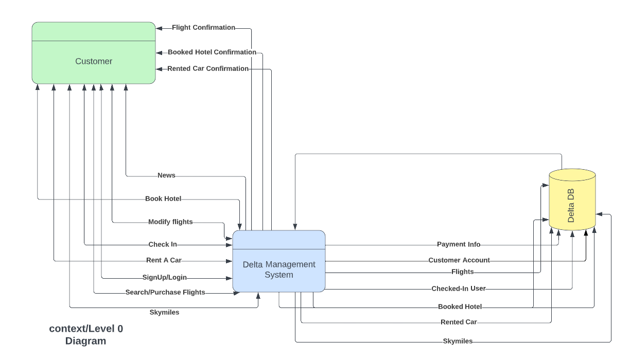
Fig. Level 0 Diagram

Slide 15
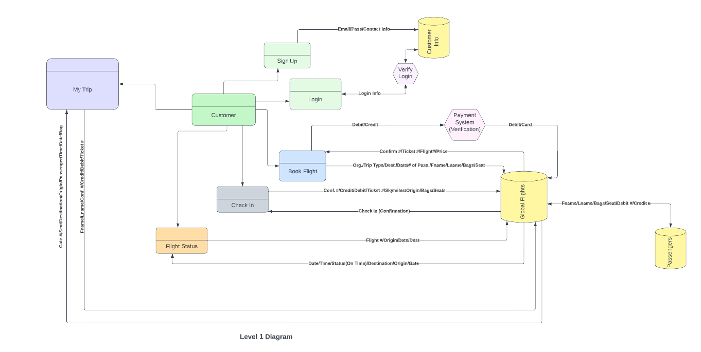
Fig. Level 1 Diagram

Slide 16
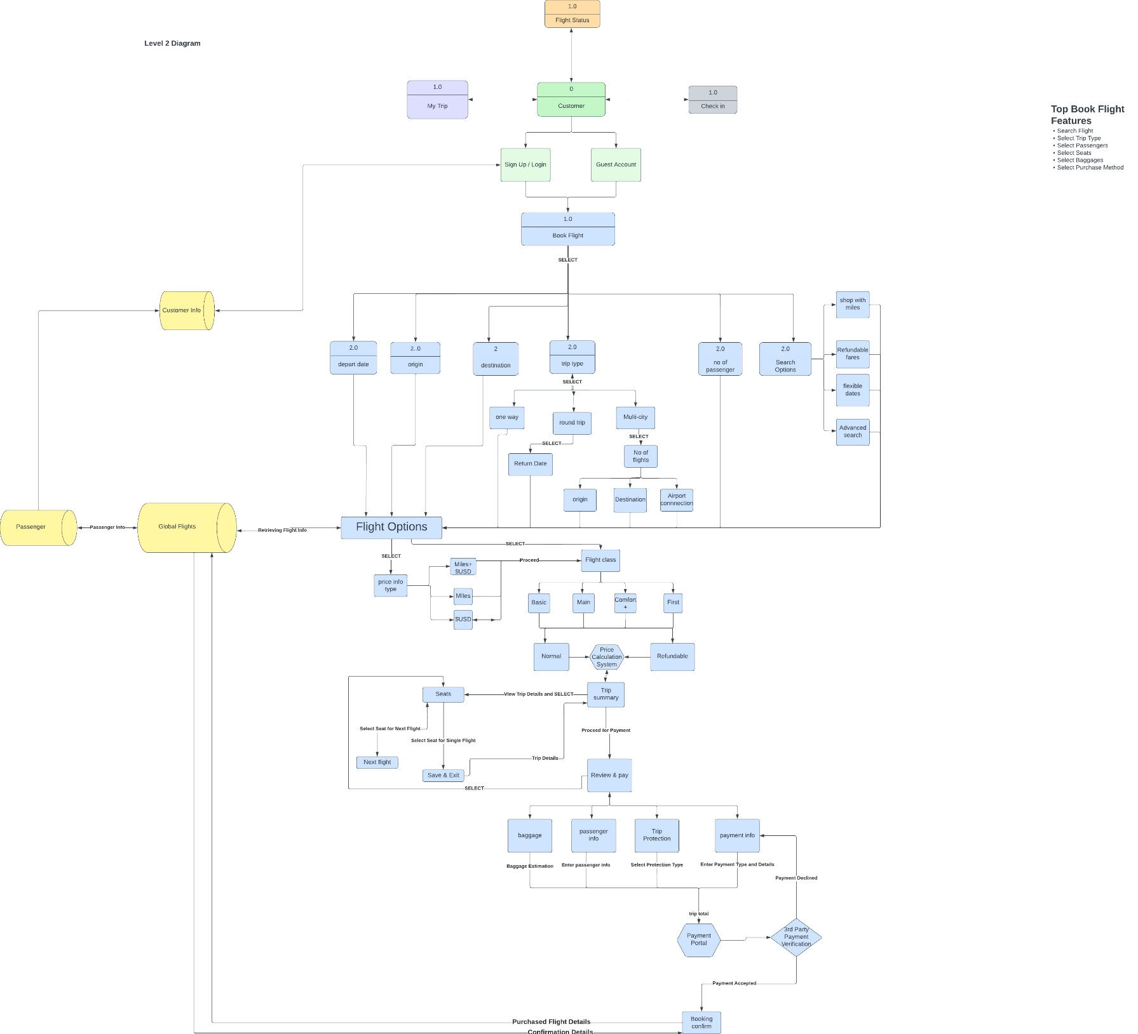
Fig. Level 2 Diagram (Process)

Slide 17
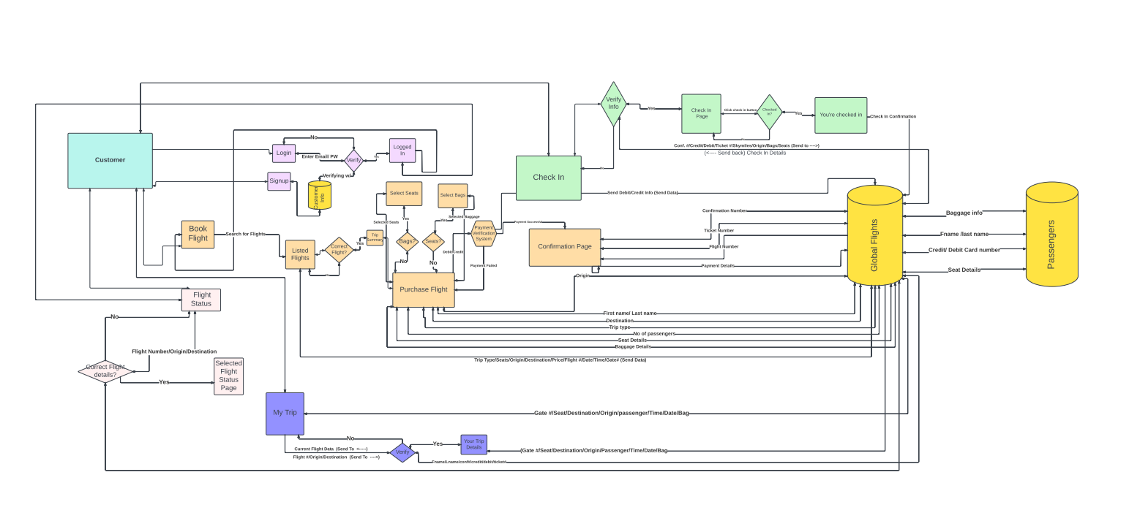
Fig. Level 2 Diagram(Data flow)

Slide 18
INTERVIEWING Shailendra Kumar Yadav Back End Engineer at Delta Airlines
Scope
Framework Discussion
Database Discussion
Interacted showing the database we designed
Review

Slide 19
THANK YOU EVERYONE! Q/A SESSION BEGINS.
Feel free to ask any questions.....

